Slide 1
Self Service Publishing Project
Patrick Desbrow
Analyze Tollgate Review

Slide 2
BPM Project Summary
Problem Statement
As of some date December 2010, the [J. D. Power] Client System Group (CSG) spends approximately 22 hours or $2,000 to publish a single study on the existing Business Center web deliverable.
Currently, there are too many individual steps in a single study. The existing process is manual and requires unnecessary IT staff to ensure accuracy.
In addition, the number of reported errors in the publishing process indicate potential issues with quality.
Defect Definition/Project Metric
D1: Labor Hours > $1,000
D2: # of Errors > 1
Objective
The aim of this project is to
Decrease this by 50% or 11 hours of labor for a syndicated research study by December 2011.
Reduce the number of reported errors on a study to less than or equal to one.
Leverage standardization and automation.
Standardization allows us to do the same thing the same way which also allows for the automation of common tasks.
This will lower cost and allow for more research deliverables.
Projected Benefits
Based on a current project chargeback rate of $90 per hour, it is estimated that this project would remove $1,000 from a study.
With over 250 Syndicated studies published on the Business Center in 2010, there is the potential for an estimated $250,000 savings each year.
The reduction of reported errors on each study will increase the overall quality of the study.

Slide 3
Analyze Key Accomplishments
Validate the quick win process for saving QA testing time in the process
Collected operational metrics for all syndicated studies published to the business center this year
Map the detail process steps for the current Business Center publishing process
Identified the major drivers of publishing time and cost
Define the area for improvement and high level solutions for each
Updated the preliminary business case with I&M Finance
The team started with the critical question:
“Why does the Business Center (BC) publishing process cost so much”

Slide 4
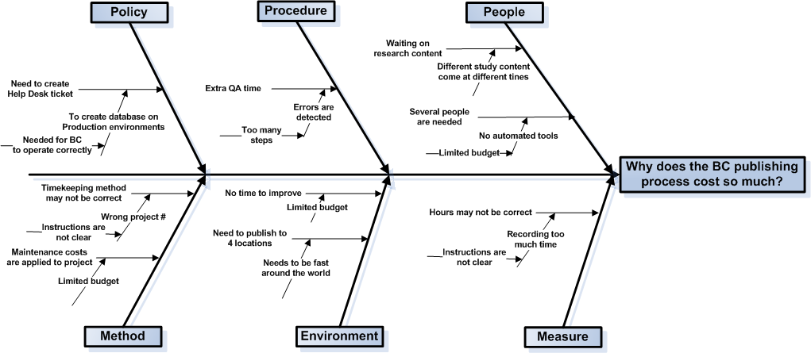
Cause & Effect Diagram
This Cause & Effect diagram illustrations that there are still opportunities to
improve the Business Center (BC) publishing process

Slide 5
Project Roadmap
2007 vs. 2011
Syndicated Study Average
Then: 277 Hours (per study)
Now: 23 Hours
Out of Scope
In Scope
Then: 77 Hours
Now: 6 Hours
Then: 200 Hours
Now: 17 Hours
Essential Project Management
Hosting
QA Testing
Global Enhancements
Client Deliverables
Business-defined pain point
Gather Requirements
Load Data
Create Web Site Presentation
QA Web site
Project Management & Release Study
Then: 40 Hours
Now: 0 Hours
Then: 40 Hours
Now: 0 Hours
Then: 80 Hours
Now: 4 Hours
Then: 25 Hours
Now: 1.5
Then: 15 Hours
Now: 11.5 Hours
Next Priority
The focus for this project is the areas that where out of scope in the last BPM project. This includes the Study Release, Quality Assurance and the remaining Project Management tasks in the process.

Slide 6
Value Stream Map – Where is time being spent?
Planned Project Tasks for Project Management
IT PM sends status to research team
Update
issue log
Review study details on loading environment
Send update(s) to research team
Coordinate publishing tasks
Notify research when task(s) are completed
B
C
B
B
Planned Project Tasks for Study Release
7 Hrs (82%) of the time spent in project manager is non value added activities.
Dev team updates study tools based on the issue log
Attend study data publishing meeting
Move data content to production via auto tools
Notify project manager that when task(s) are completed
Load users / assign roles using tool
Notify project manager that when task(s) are completed
A
B
B
0.5 Hrs (33%) of the time spent in Quality Assurance is non value added activities.
0.5 Hrs (17%) of the time spent in study release is non value added activities.
Planned Project Tasks for Quality Assurance
Attend study data publishing meeting
Review study tools on loading environment
Report defects to project manager
Review study tools on production
Review users / assign roles on production
Notify project manager that when task(s) are completed
A
C
B
Forms of Waste
(Non Value Added Activities)
A
There are a number of areas for improvement
The highlighted boxes emphasize the need for a new process and new tools that support automation.
Processing
B
Motion
C
Defects

Slide 7
Analysis Findings
Labor hour can be removed
  Goal 1: Project management tasks (7.0 hours, a 82% reduction)
  Goal 2: Study release process (0.5 Hours, a 17% reduction
  Goal 3: Quality assurance steps (0.5 Hours, a 33% reduction)
Other drivers of waste
  Goal 4: Other General / Setup tasks (2.0 Hours, a 33% reduction)
Total Saving Potential: 10.00

Slide 8
Critical Root Causes & Effects
Original Issue | Root Cause | Benefit of Correction
Goal 1: Project Management The process is dominated by numerous email notifications and status meetings to plan and publish the data and content for a study on the Business Center. | There is a need to commutate status to research, IT and QA personal throughout the process. The current process uses emails and meetings. | PM time can be reduced if the communication process is optimized. This means fewer meetings and email notifications.
Goal 2: Study Release The release process is composed of two push events to production on two separate days. There are time consuming meetings and notifications around the two push events. | All of the study deliverables are not completed until just before the publishing date. The data and content are pushed separately to ensure the publishing date is met. | Improve the process to allow for a self service style pushing events The current IT staff will operate in a support role only. The pushing events will be controls by the PM.
Goal 3: Quality Assurance The QA process is a set of validations targeted at the study a) content, b) tools and c) user permissions on the Business Center in three locations around the globe. | The QA steps are the same for each type of pushing event. This can be optimized based on the content and the location. | The QA time can be reduced as validations will only the target the areas in the study that have changed since the last publishing event.

Slide 9
Initial Improvement Recommendations
Current: IT managers meet with research teams to discuss the process steps and collect key dates in the publishing schedule.
Recommendation: Replace meetings with a new tab in Research Tool (RT) to collect and store dates.
In addition, a online sit preparation checklist could be added to ensure all of the RT steps are understood.
Current: Research teams update a global master publishing schedule in MS Excel.
Recommendation: Replace the global master publishing schedule with the same tool in RT (above).
Current: IT manager sends emails to the research team when key events take place in the publishing process.
Recommendation: RT already sends email alerts. These alerts can be extended to the publishing process as well.
Current: IT manager maintains offline metrics and reports around the process.
Recommendation: Move the offline metrics and reports into RT and create a management dashboard.
Current: User permissions are loaded to the Business Center using a combination of manual and automated steps.
Recommendation: Automate the remain steps in the user administration tool and site QA process.

Slide 10
Next Steps
Project Task Owner Target Date
Develop project statement of work Project Management Team 12/15/2011
Create a detailed project plan Project Management Team 12/15/2011
RT Web site Update – Sprint 1 Technology Team 01/15/2011
Web Site Auditing and Validation Research 01/20/2011
RT Web site Update – Sprint 2 Technology Team 02/01/2011
Web Site Auditing and Validation Research 02/15/2011
BPM Control Phase/Handoff BPM Team 03/01/2011

Slide 11
Appendix

Slide 12
Major Areas for Improvement
Load data to the production environment (Publishing Process)
    Each project can have a high degree of customization
    Programmers currently need to manually move the data and other content between servers ( loading, QA, production environments)
    This process goes through a number of cycles until correct
    This includes the list of users that will have access to the study
Numerous QA Testing Checks Through the Process
    There is a quality assurance test step for each of these manual processes
    The aims is to reduce the amount of testing before a study is delivered
    This includes checking a sample of the users that will have access to the study
Note: There are at least 11 hours of labor saving in these 2 improvement areas
The diagram on the next two pages will highlight the cycle time (C/T) hours

Slide 13
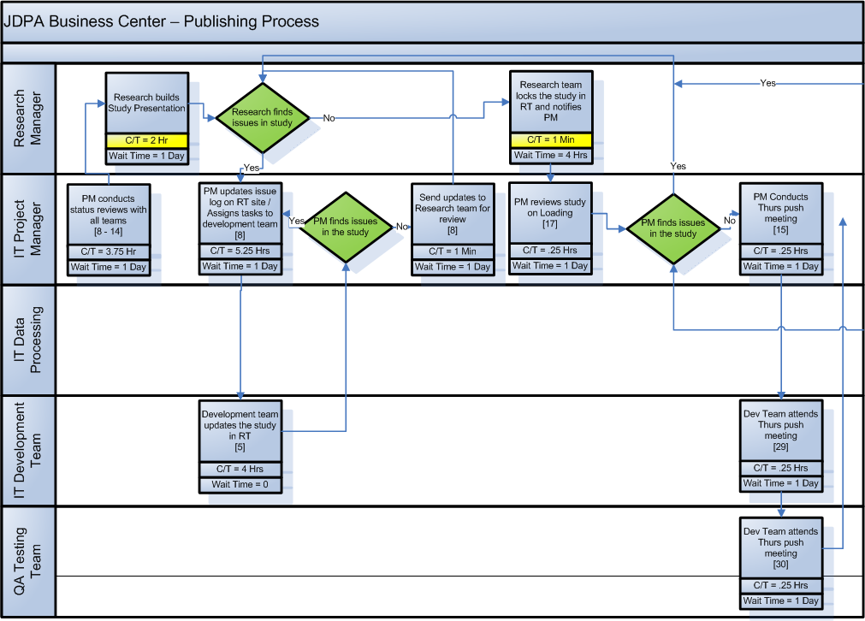
Detail Process Map
1
2
= Opportunities

Slide 14
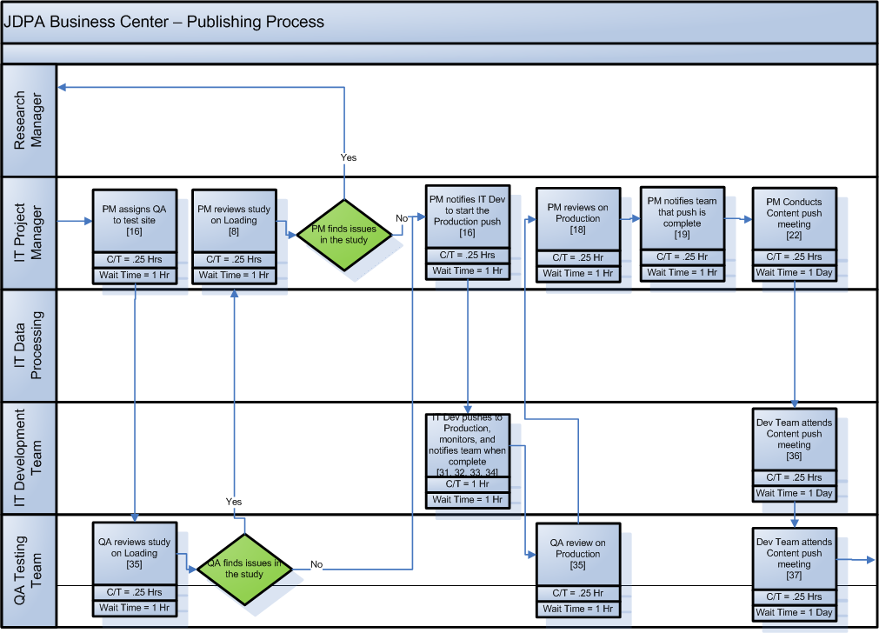
Detail Process Map
1
2
= Opportunities

Slide 15
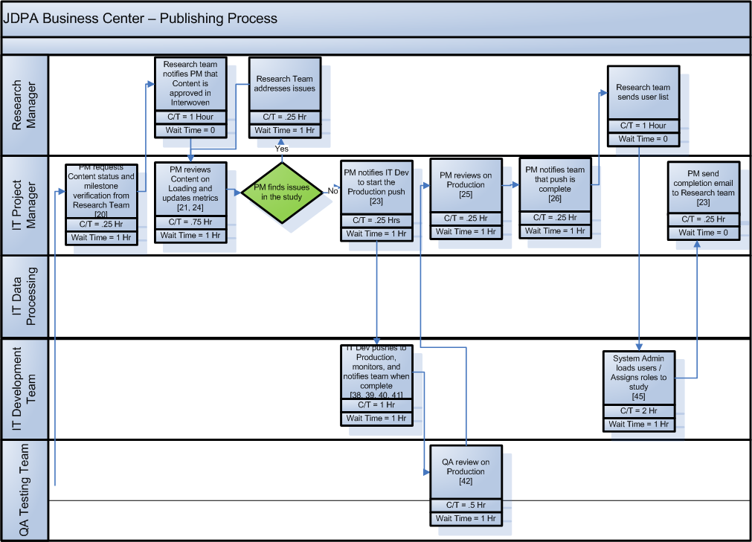
Detail Process Map
2
1
= Opportunities

Slide 16
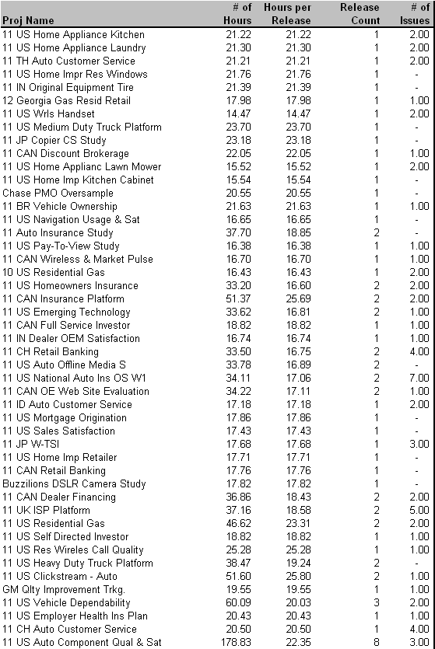
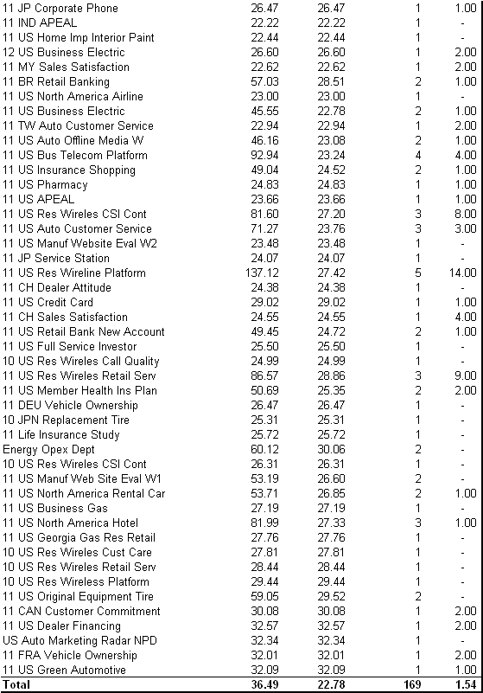
Financial Analysis - Baseline Data
1.
An average of 22.78 hours are spent on activities related to publishing
Source: Full labor hours capture through Timepiece. Contract labor hours captured through ActTime
Notes:
The initial project charter was still rather broad – identifying a need for improvement within the broad spectrum of executing a mail-based study. In that regard, it was important for us to walk through the process and talk to process owners, practice leads, and research project managers to identify the key stakeholders and internal customers. This helped us understand the pain points throughout the process
From the walk-through and interviews, we learned a few things:
1. The existence of a number of handoffs and verification steps that have been institutionalized in our processes
2. An understanding of how scope of work changes and input variation impact our Client Operations (i.e. research production) activities, and
3. The type of data available and necessary for us to gather and analyze in order to prioritize our pain points

Slide 17
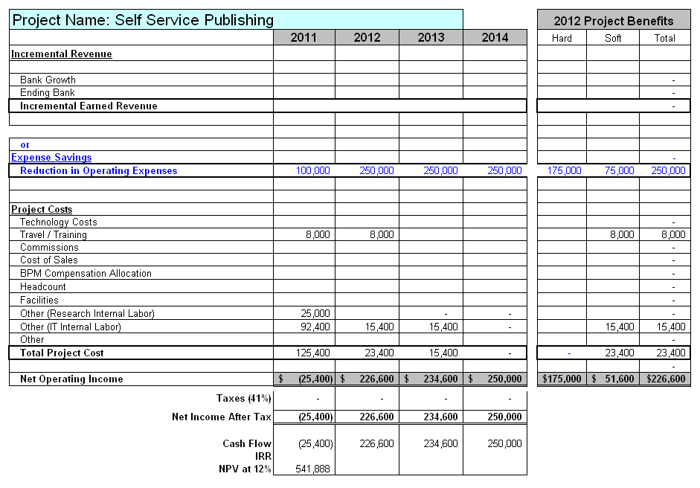
JDPA Business Case Summary

Slide 18
Assumptions
Study Assumptions
190 - Number of studies published each year
250 - Number of publishing event including wave and oversamples
The project is excluding the most complex study that require far more then 22 hours to complete
Labor Improvement Assumptions
Improvement in IT labor hours (50%) associated with the following activities:
  Reducing project management time
  Reduce QA testing tasks
Cost Savings Assumptions
Reduce labor by 11 hours per project
$1,00 cost saving per study
100 projects in 2011, 250 project each year after
Resource Assumptions
70 % of the contract resources will be retired resulting in a hard cost saving of $175,000 in 2012.
All other resources for the soft savings will be moved to other projects outside of the syndicated
Other Assumptions
Travel: $1000/trip x 2 trips x 2 employees = $4,000
Training: $1,000/session x 4 sessions = $4,000
Two senior research managers will participate on the team as the internal customer = $25,000
Two IT programmers for 3 months will create tools to reduce the cost of the publishing process = $92,400.
No software or hardware costs. (These costs are part of the Research Tools project)

